Slide 1
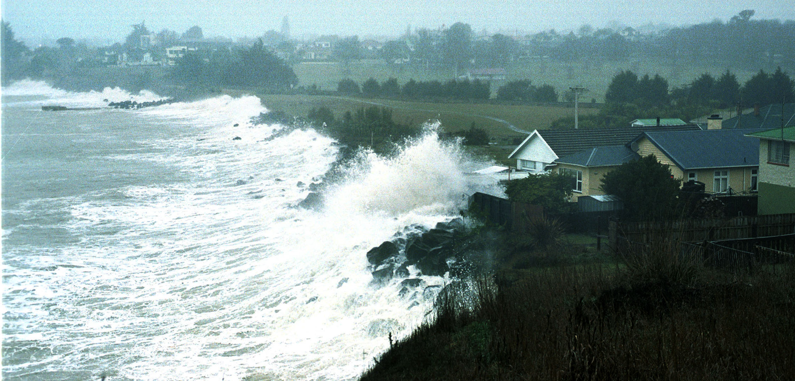
Metamodeling for Vigilance Vagues- Submersion by integrating functional inputs and outputs
Paul SLISSE
Victor DAVODEAU

Slide 2
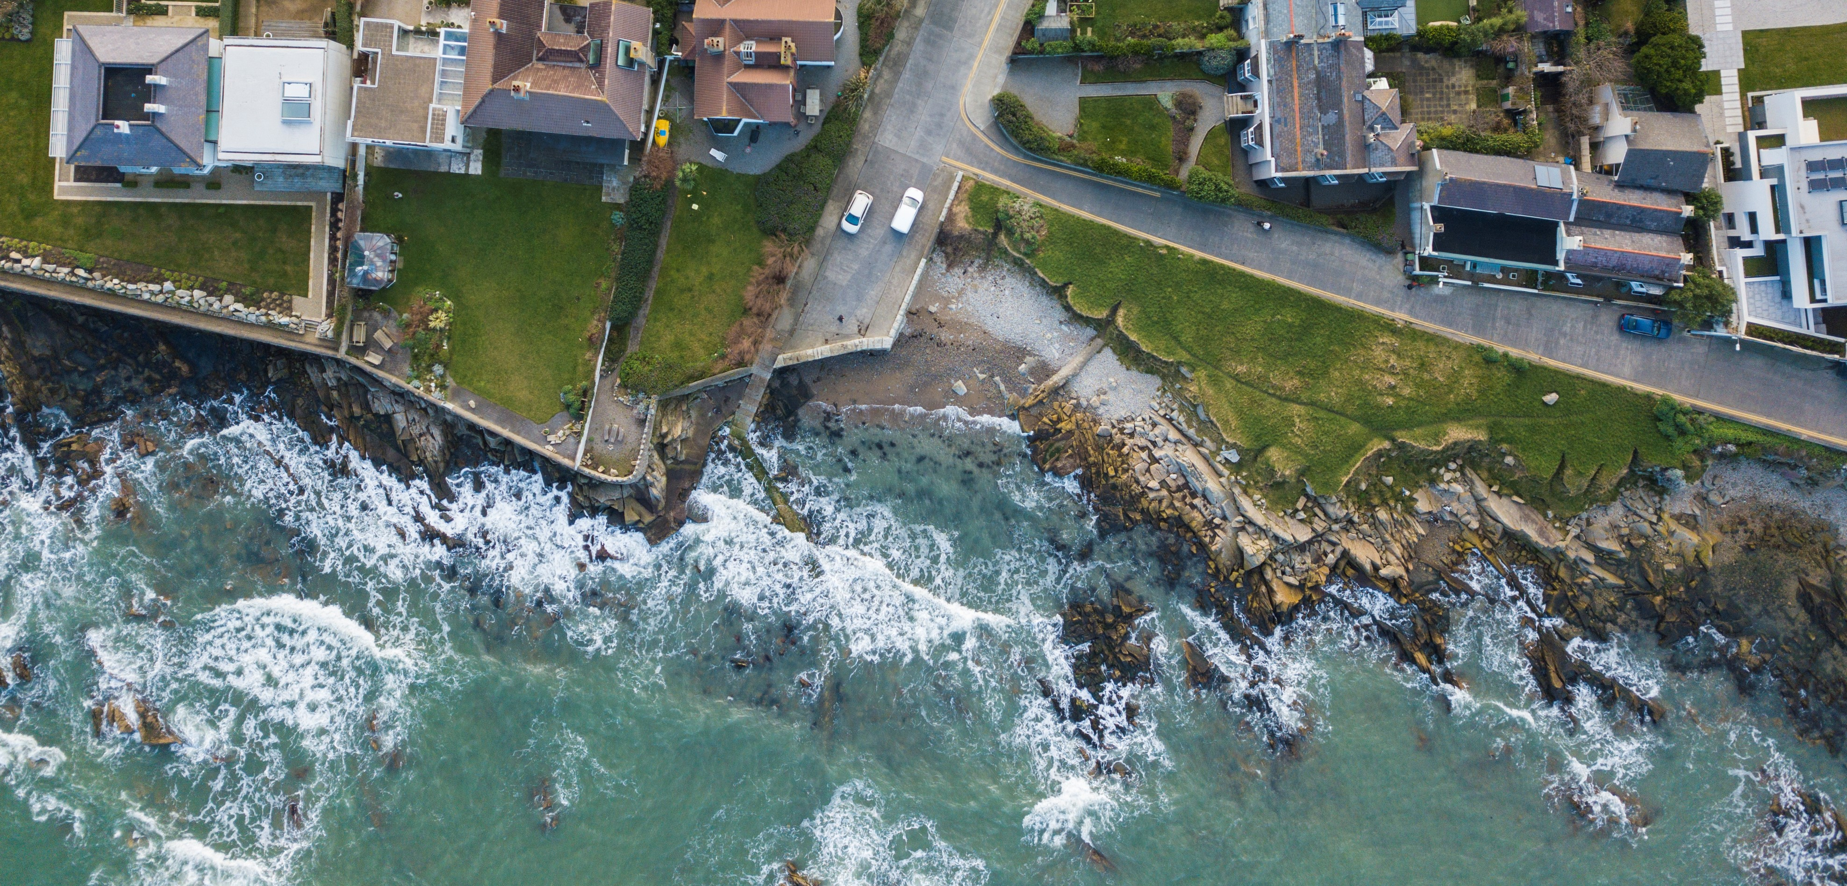

Currently we can’t predict the risk of coastal flooding locally and in real time !
Notes:
« Problem slide with regular words »

